Slide 1
The Down States
Focus: Activity in preparatory period [cue-off go-on]
and subsequent reaction time (RT)

Slide 2
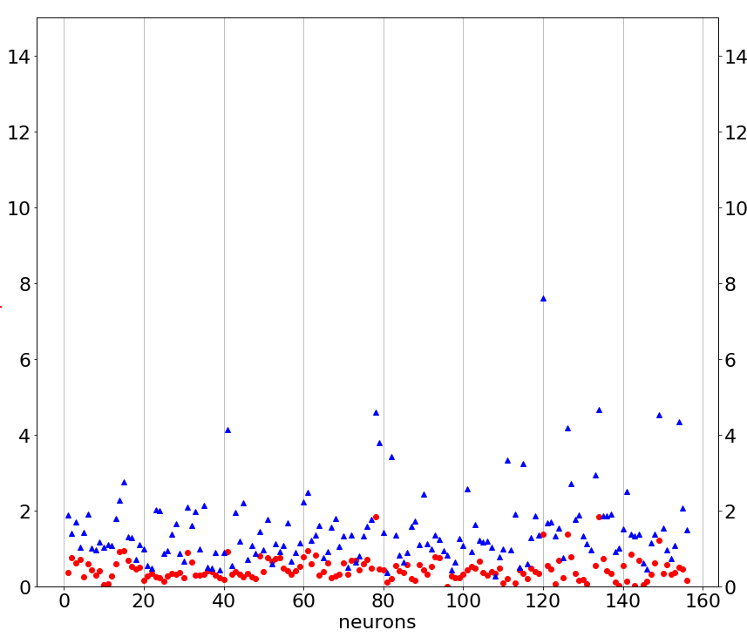
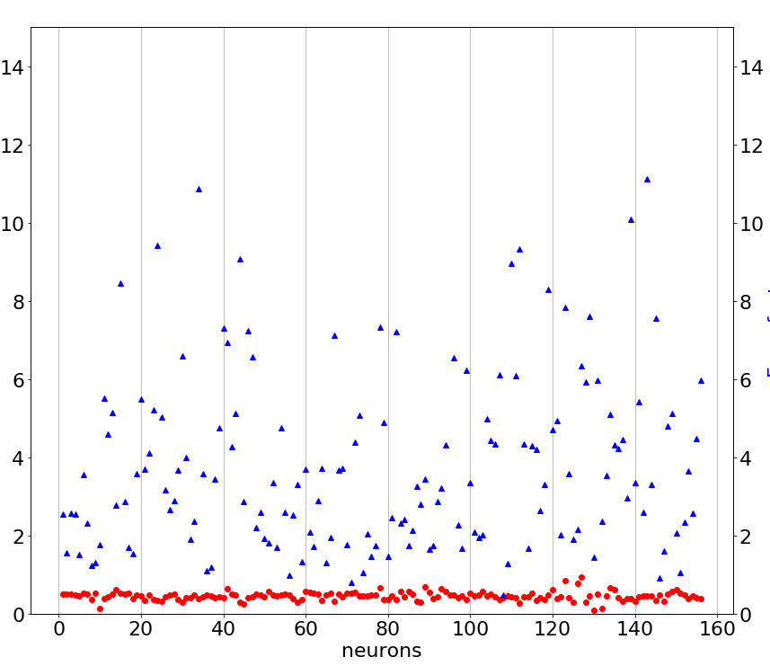
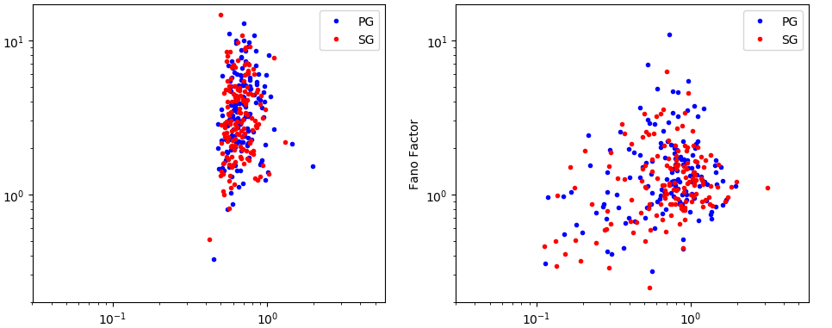
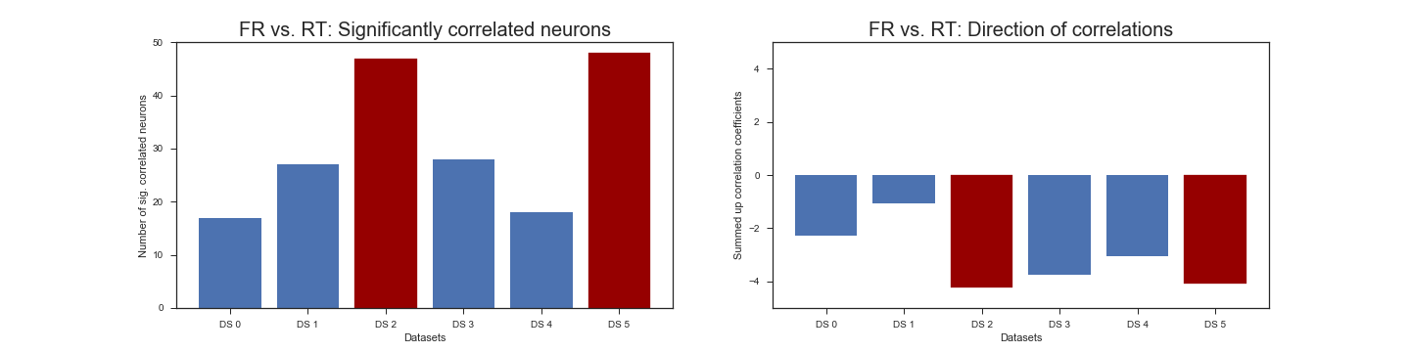
Chain of evidence – Part 1: Dichotomy in the datasets
CV²
vs.
Fano
CV2²
vs.
Fano
Data 0, 1, 3, 4
Data 2, 5
Data 0, 1, 3, 4
Data 2, 5
Firing Rate vs. RT
Number of significantly correlated neurons
PCA clusters
Data 0, 1, 3, 4
Data 2, 5
Datasets

Slide 3
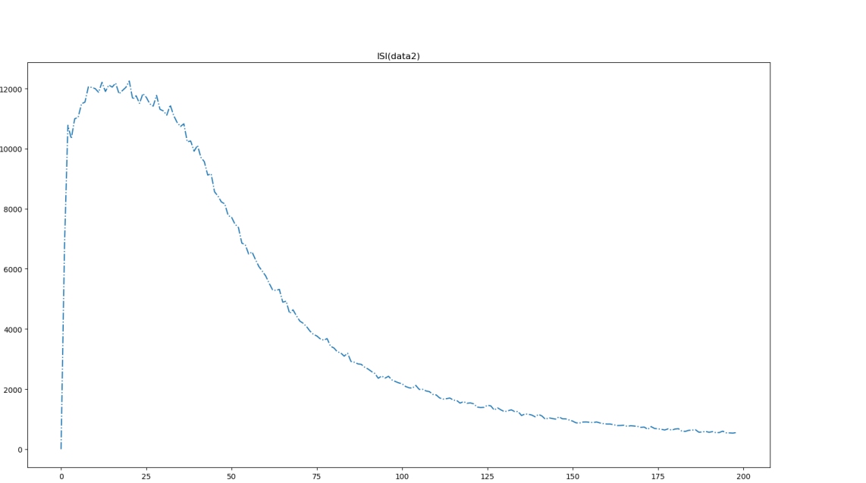

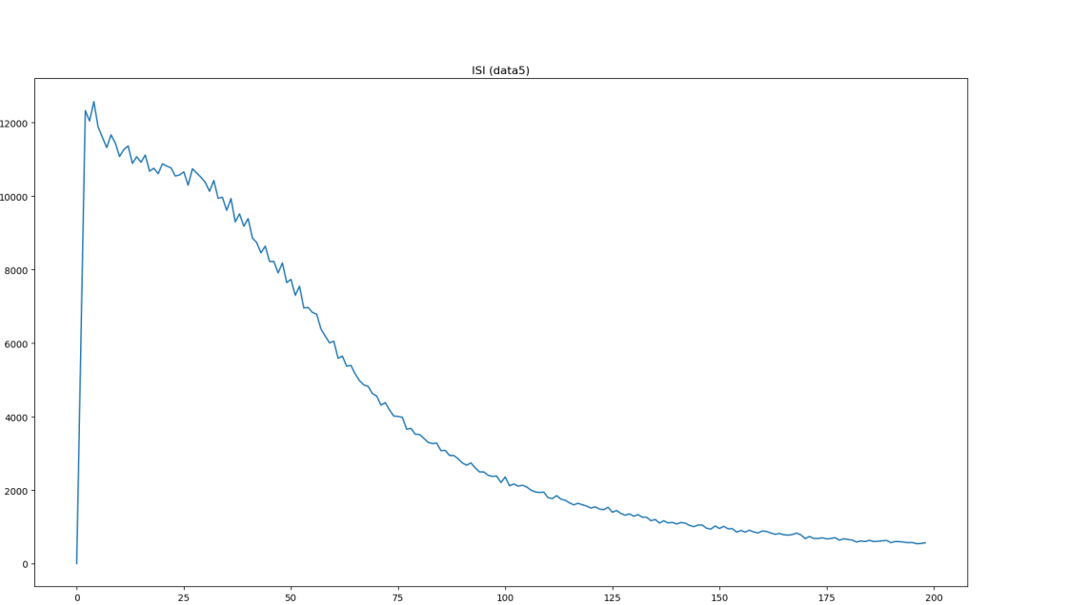

Chain of evidence – Part 2: Is it dataset 2 or 5?
Dataset 2
counts
ISI (1 ms bins)
Dataset 5
counts
ISI (1 ms bins)

Slide 4
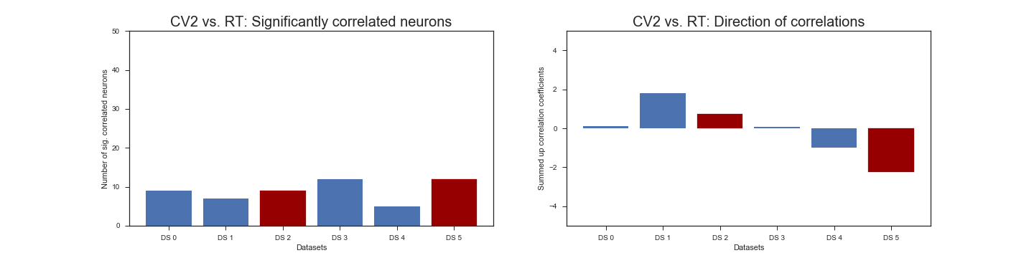
Correlations Firing Rate vs. Reaction Time – A closer look

Slide 5
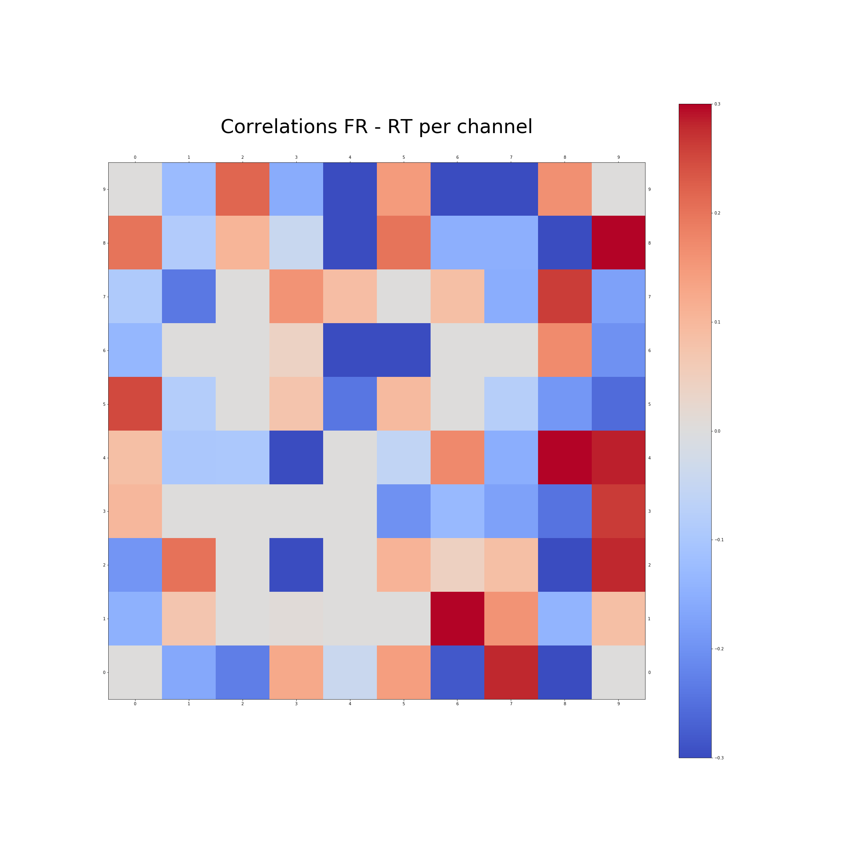
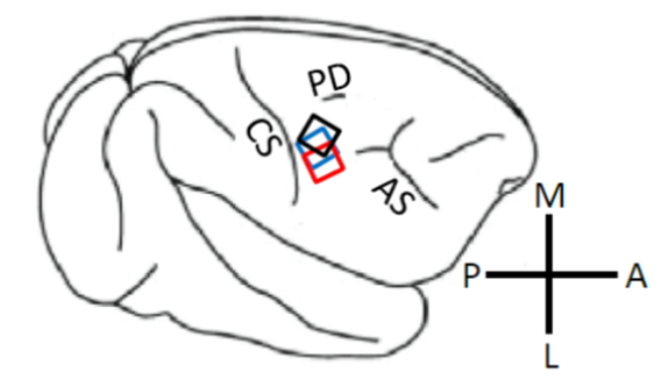
Correlations Firing Rate vs. Reaction Time – A closer look
0.3
0
- 0.3

Slide 6
Correlations Firing Rate vs. Reaction Time – A closer look
0.3
0
- 0.3

Slide 7
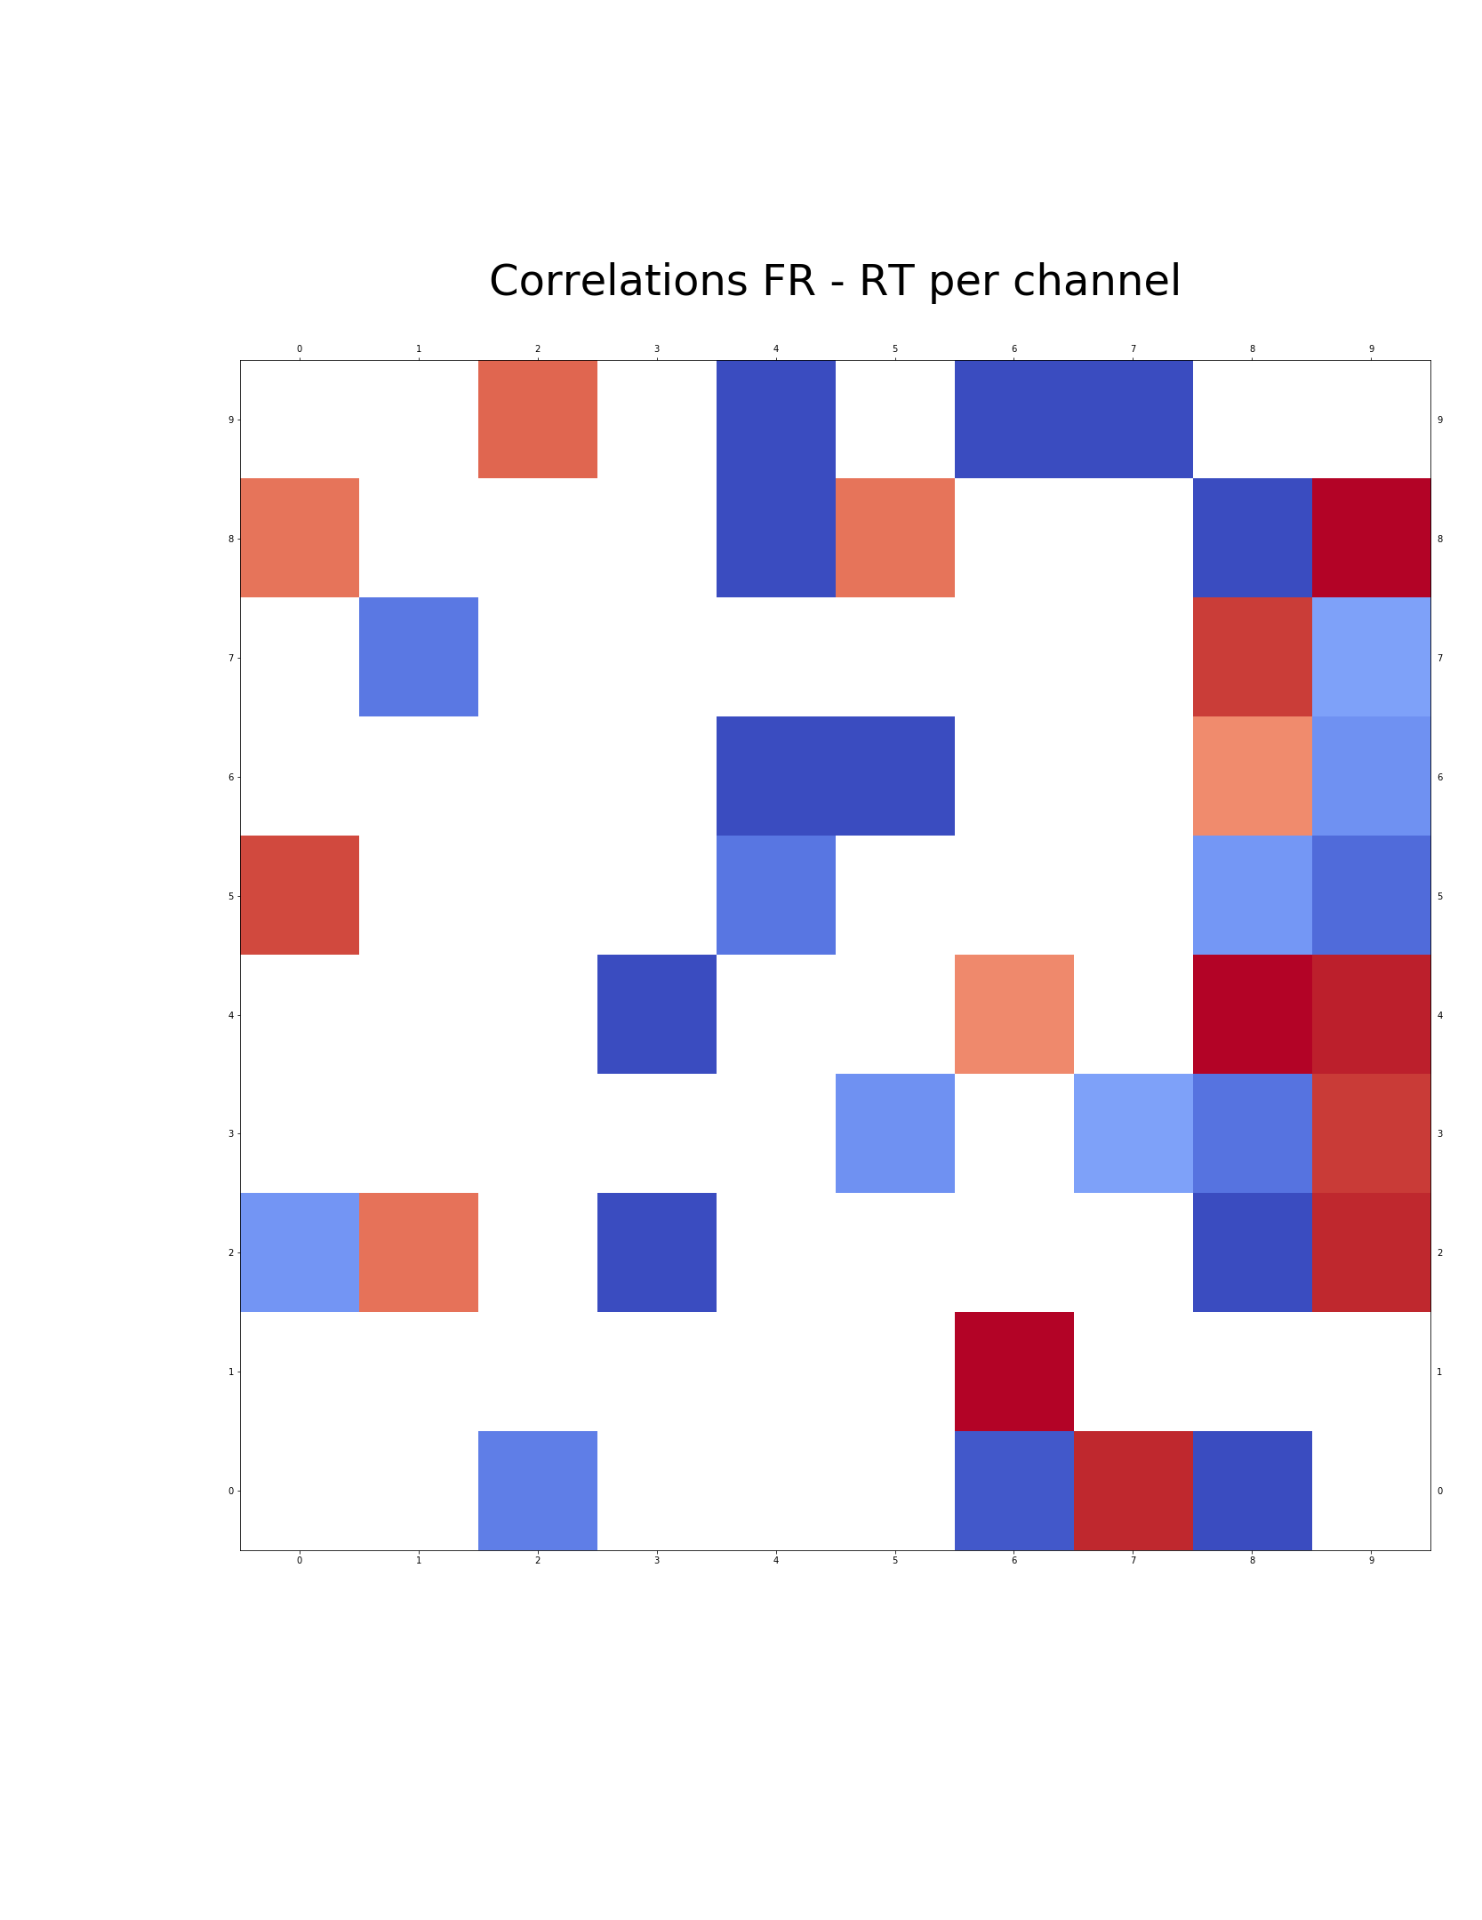
Correlations Firing Rate vs. Reaction Time – A closer look
0.3
0
- 0.3

Slide 8
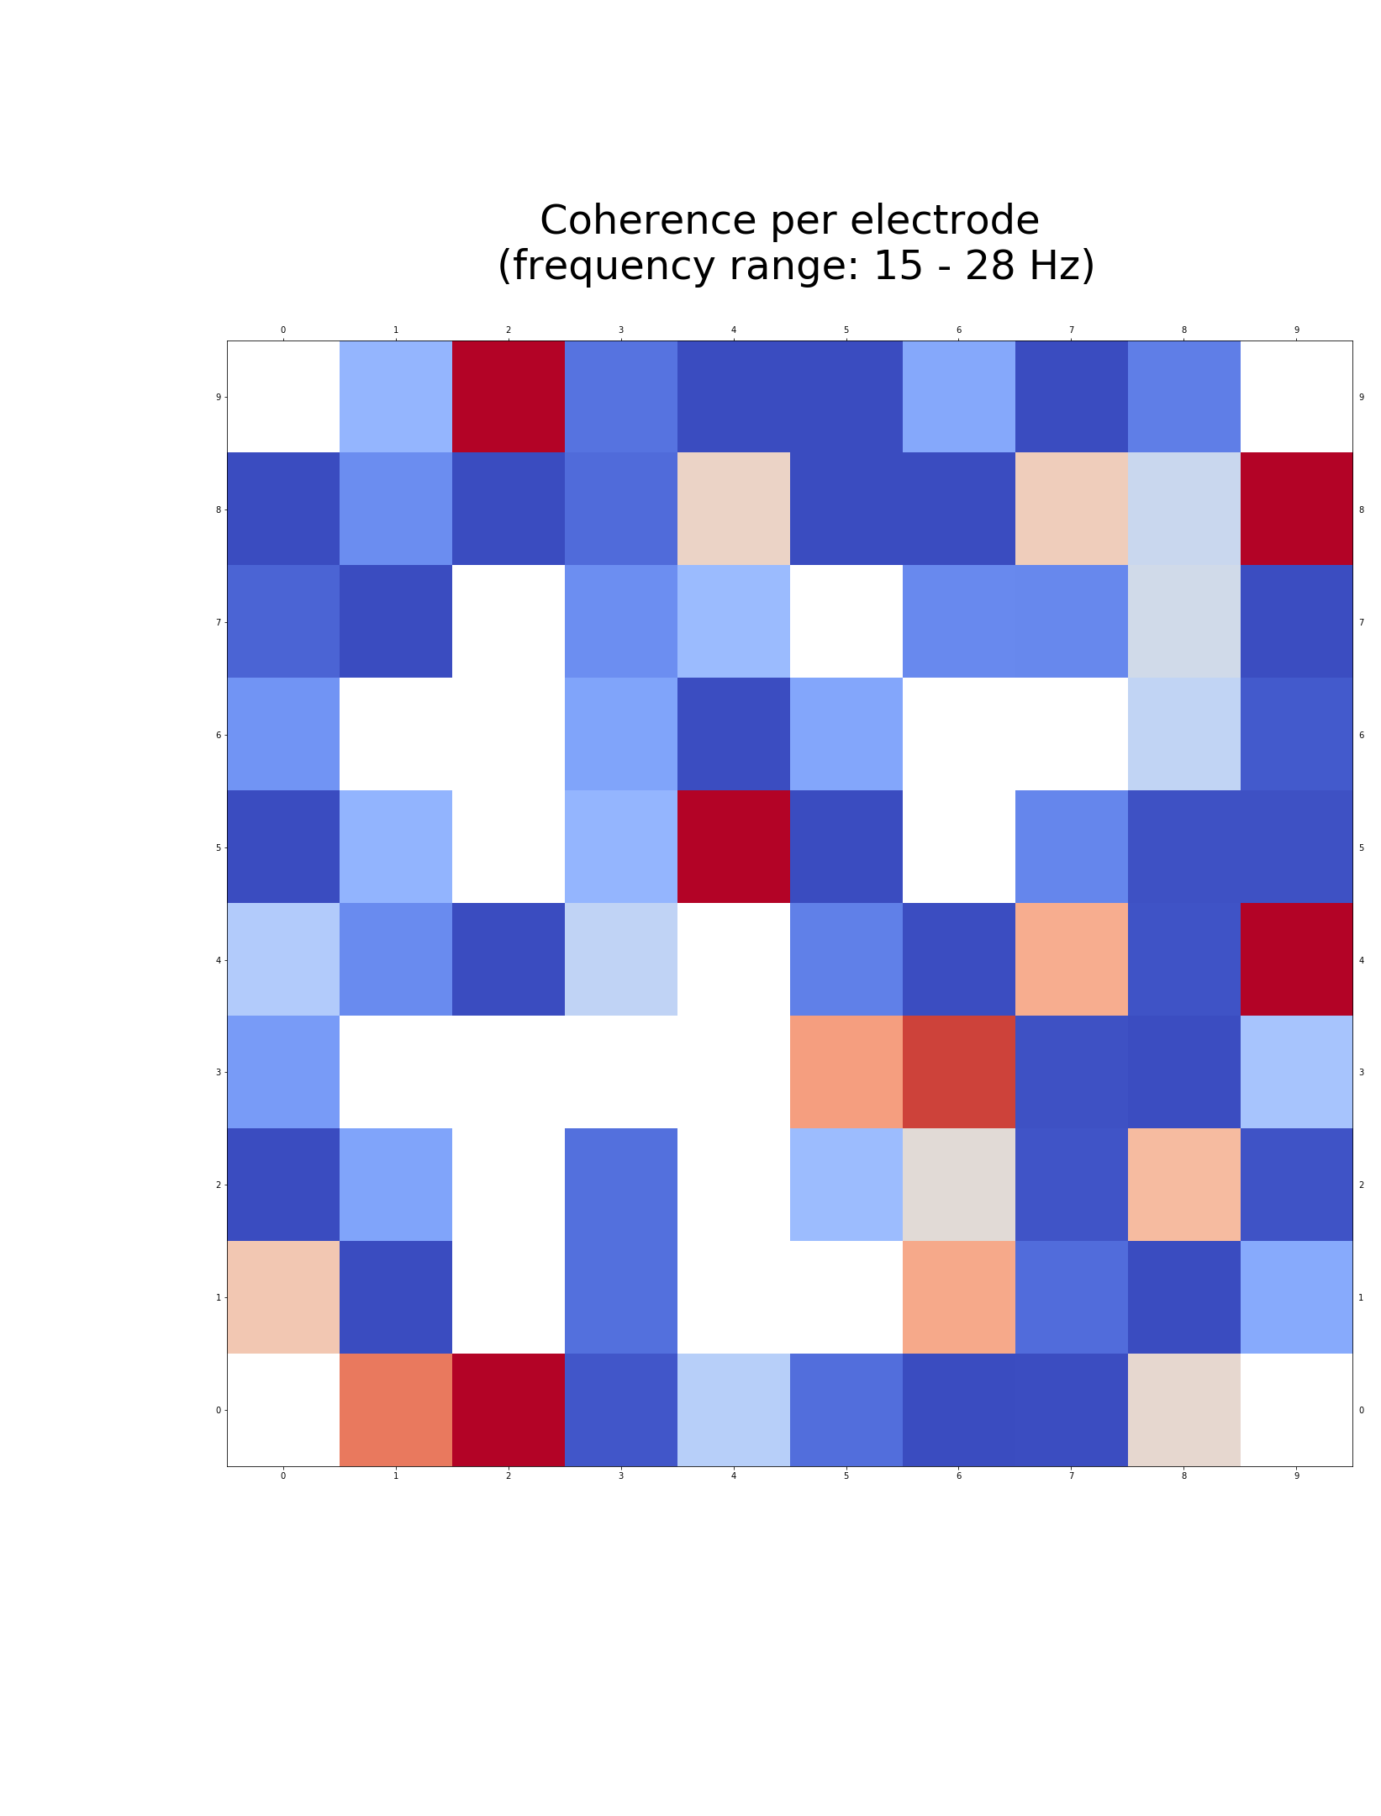
Spike-field coherence
0.01
0
- 0.01

Slide 9
Spike-correlations across channels

Slide 10
Spike-correlations – A closer look (cross-correlation)

Slide 11
PCA – A closer look

Slide 12
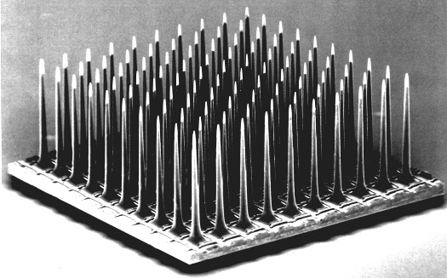
Correlation coefficient and distance
Gordon Kindlmann, NIH Symposium

Slide 13
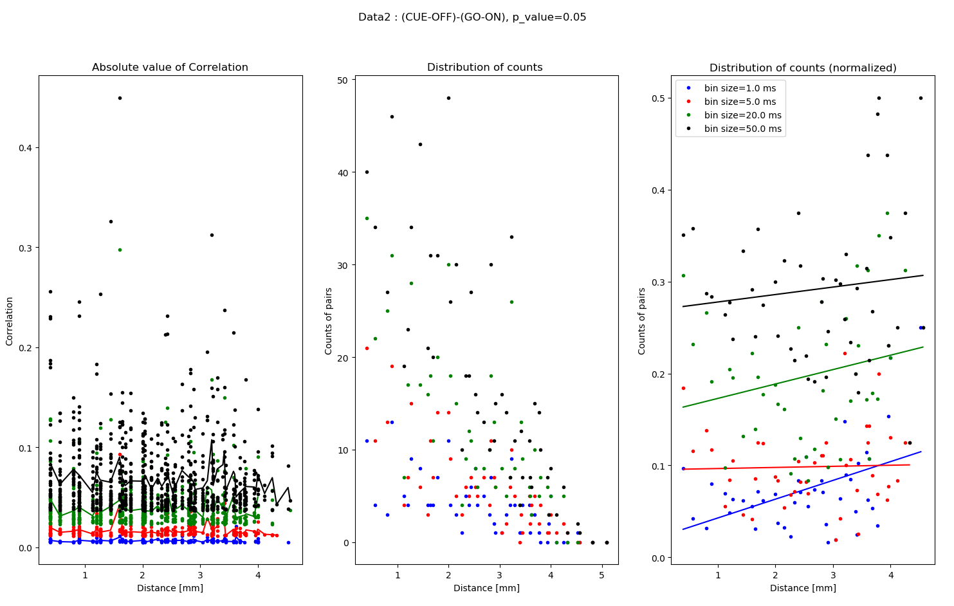
Correlation coefficient and distance

Slide 14
Outline
Part 1: Old shit
How did we find the real dataset?
Slide 1: one pieve of evidence in each corner
Slide 2: ISI nail in the coffin
Part 2: New data!
Jens: Correlations FR-RT across channels
Jahan: Correlations between units across channels
Lungsi: Adding time-resolution with pairwise cross-correlations on a subset of pairs, show eg. 3 pairs in different colors -> 3 cross-corr curves
HP: Fancy PCA movie
Part 3: Conclusions ??

